Slide 1


Slide 2

Workforce Optimization In The Customer Channel Choice World
Session 205
Tim Montgomery, Managing Partner, Culture.Service.Growth (CSG)

Slide 3




CSG’s Founders have advised some of the world’s most recognized service organizations

Slide 4

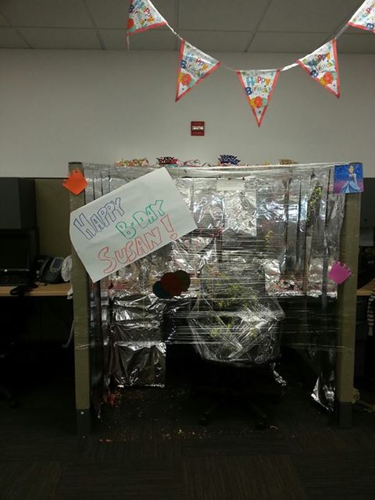

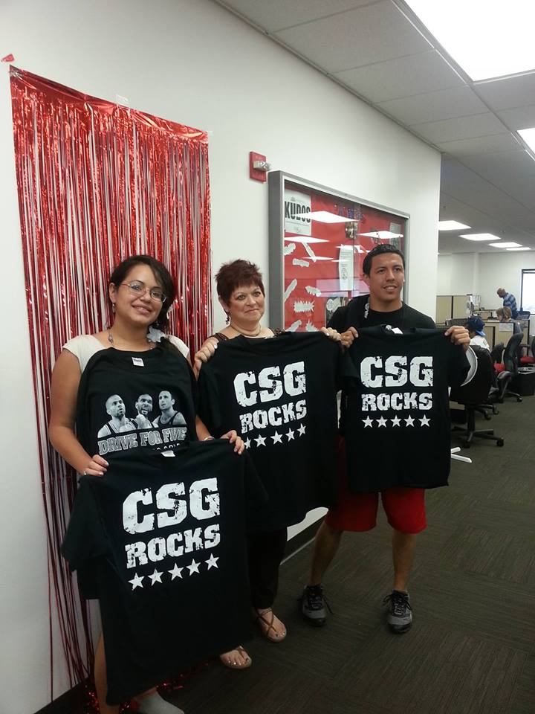
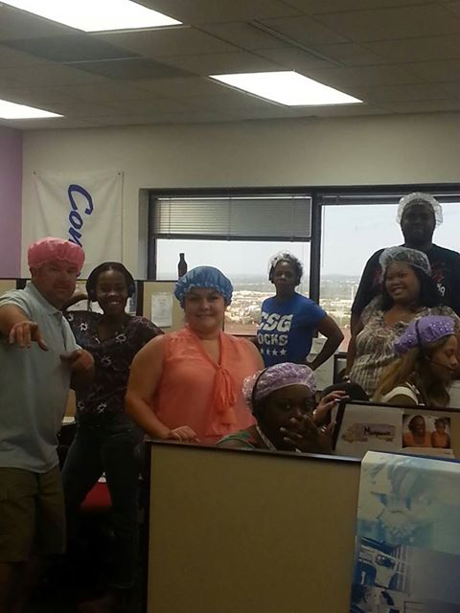

Slide 5

The Call Center Leader
If it wasn’t for that math…

Slide 6

Random
IS
Planned

Slide 7
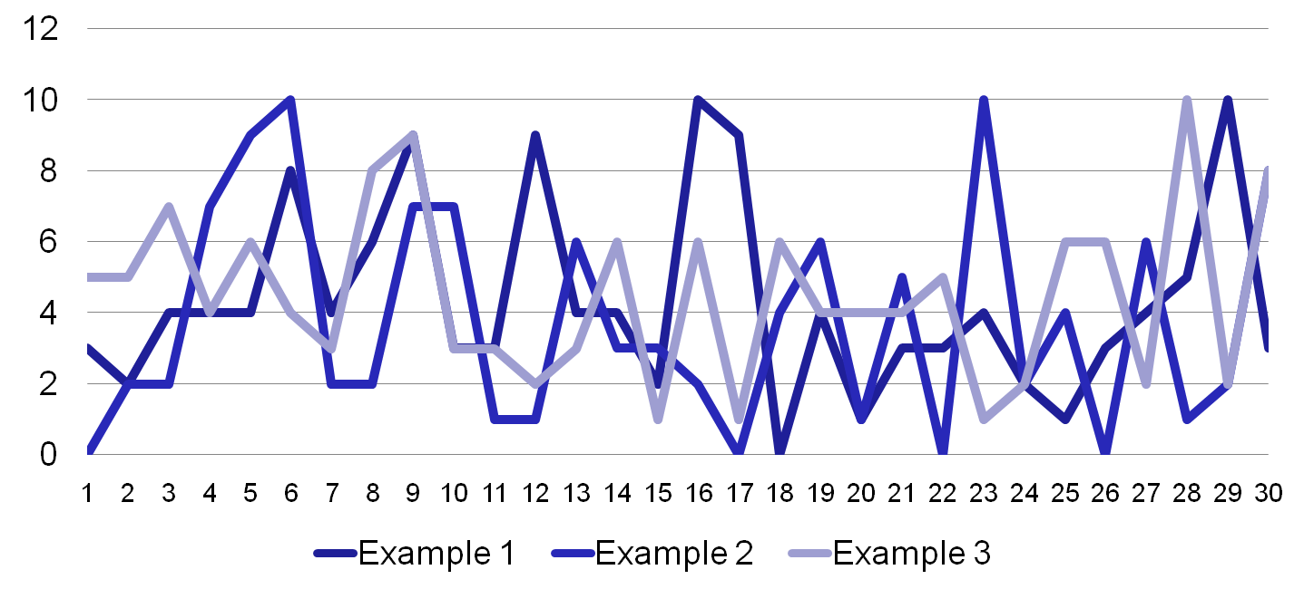
150 Calls arriving minute by minute in an interval
Notes:
The Profession

Slide 8
Staffing
IS
Math

Slide 9
@ a 6 minute handle time we’d staff 35 people to meet an 85/30 SL for the three examples.
Notes:
The Profession

Slide 10

How Many
How
Long
How Quick

Slide 11
How is it different?
We still need history
Volume
Handle Times
Trends
We still want a defined service goal
We still have to know about planned changes

Slide 12
Workforce design considerations
Voice and chat
Non-deferred
Immediate interaction
Staffing based on SL/AHT
e-Mail and fax
Deferrable
Response can be planned
Staffing based on non-peak hours
Social media
Deferability based on media type
Response timing based on media type
Staff to immediate, buffer for the rest

Slide 13
Forecasting design considerations
Measure by
Service Level /ASA
< 2 hours
Text
Web Chat
Walk-ups & Escalations
Phone
Measure by
Response Time
> 2 hours
Social Media
Fax
e-Mail
Mail
Notes:
Removed animation

Slide 14
The WFM Process

Slide 15
Planning and Management
 | Traditional Call Center | E-Enabled Call Center
Choose a Service Level | ✓ | ✓
Collect Data | ✓ | ✓
Forecast Workload | ✓ | ✓
Calculate Base Staff | ✓ | ✓
Calculate System Resources | ✓ | ✓
Calculate Shrinkage | ✓ | ✓
Organize Schedules | ✓ | ✓
Calculate Costs | ✓ | ✓
Repeat for Service adjustments | ✓ | ✓

Slide 16

Staff Model Overview
Capacity: % of paid hours spent processing workload
Workload: Volume x handle time
Capacity element: An activity that requires a time investment from staff without producing any completed transactions.
Workload element: A measurable transaction to be completed by staff.

Slide 17
An E- mail Run Rate Analysis

Slide 18

timm@csg-email.com

Slide 19
Thank you for attending Please complete your session evaluation

